Slide 1
K90

Slide 2
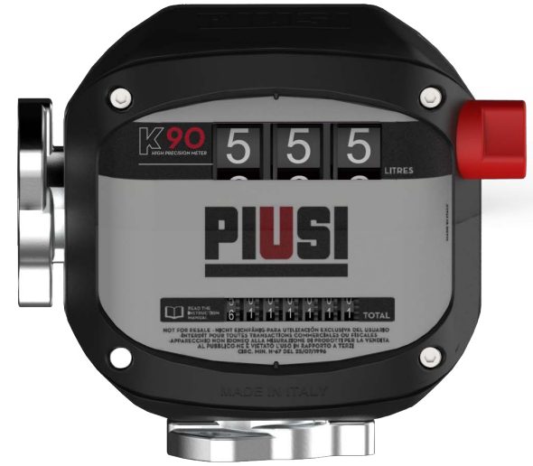
KEY BENEFITS
Proprietary & patented design;
Compact & Sturdy (improved plastic materials);
Easy installation;
High precision;
High visibility;
Mechanical;
Modern design;
Defense against competition.

Slide 3
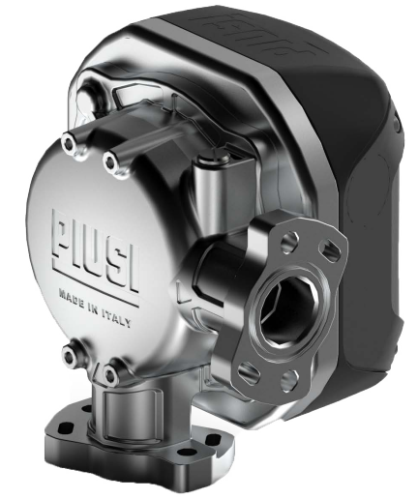
WHY K90 & MAIN FEATURES
Up to 90 l/min
Inlet & Outlet flow: 90°
Accuracy: ±0,6%*
3 digit display and 7 digit totalizer
Temperature: -20/+55° C
Max pressure: 3,5 bar (50 PSI)
Technology: Nutating Disk
*in 50-70 l/min range

Slide 4
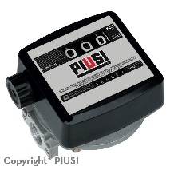
K33 AND K90 COMPARISON
 | K33 | K90
Design | No patented | Patented
l/min | 20 – 120 | 20 – 90
Accuracy | ±1%* | ±0,6%*
Display | 3 digit display; 6 digit totalizer | 3 digit display; 7 digit totalizer
Temperature | -10° +60° C | -20° +55° C
Installation | In line with the market | In line with the market
Calibration | In line with the market | In line with the market
Perceived quality | In line with the market | High-end
Threaded | Yes | Flanges (optional)
Certifications | CE, ATEX | CE, UL
*in 50-70 l/min range

Slide 5
FLUIDS & VERSIONS
K90 CE
Diesel up to B7
HVO
XTL

Slide 6
RANGE
K90 CE
CODE | F009SW000 | F009SE000 | F009ES000 | F009WS000
ASPIRATION | Below | Below | Right | Left
DELIVERY | Left | Right | Below | Below

Slide 7
THANKS

